Slide 1
Quick!
What is a crime?

Slide 2

So, just how much has to be proven in court to find someone guilty of a crime?
Burden of Proof
The prosecution has the burden of proof and must prove beyond a reasonable doubt that the defendant committed the crime.
Prosecutor–Lawyer representing the people who is attempting to gain a conviction. Must provide proof.
Defendant – Party charged with committing a crime.

Slide 3
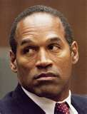
Did you know…
Many individuals/parties that are accused of a crime can be sued for civil damages or actions, even if not found guilty!
Why??

Slide 4

Criminal Laws
Laws that describe offenses against society
Enforceable by punishment …
    Incarceration
    Fine
    Restitution
    Community Service
    Probation
    Execution
    Alternative sentences such as treatment program, house arrest, etc.
    Any combination of the above

Slide 5

Classifications of Crimes
Felony – a major crime that is punishable by a fine, imprisonment, or both. Examples include murder, murder, and arson
Misdemeanor – a less serious crime which is punishable by a fine, jail time or both. Maximum usually will be less than a year and less that $1000.
Infraction – a minor offense that is usually punishable by a fine and not jail time. Examples include minor traffic violations.

Slide 6
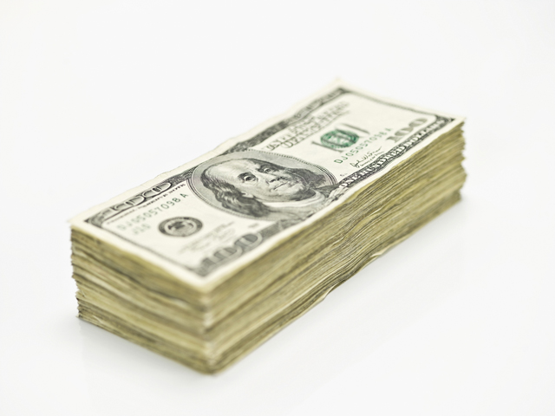
Level of Crime
Felony
    Punishable in state prison for more than1 year
    Fine of more than $1,000
    Any combo of both
Misdemeanor
    Punishable in county/city jail for 1 year or less
    Fine of $1,000 or less
    Any combo of both
Infraction
    Lesser misdemeanors
    Punishable only by fine—no risk of jail
    No right to jury

Slide 7
Crimes
Larceny
    Stealing; theft. Wrongful taking of money or property belonging to some one else, with intent to deprive the owner of it.
Robbery
    Taking of property from another’s person or immediate presence, against the victim’s will, by force or fear.
Burglary
    Entering a building without permission when intending to commit a crime.

Slide 8

Crimes
False Pretenses
    Obtaining money or property by lying about a past or existing fact.
Forgery
    Falsely making or materially altering a writing in order to defraud.
Receiving Stolen Property
    Knowingly receiving or buying property known to be stolen with the intent to deprive the rightful owner of the property.

Slide 9

Crimes
Bribery
    Unlawfully offering or giving anything of value to influence performance of an official in the carrying out of his/her public or legal duties.
Extortion
    Obtaining money or property from a person by wrongful use of force, fear, or the power of office.
    Also known as blackmail.

Slide 10

Crimes
Arson
    Intentionally starting a fire or explosion that damages or destroys a building or other property either
      without the owner’s permission.
      With the intent to defraud.
Conspiracy
    Agreement between two or more persons to commit a crime.
Computer Crime
    Unlawful taking, copying, manipulating, altering, or erasing of electronic date
    Committing a crime using electronic means.

Slide 11

White-Collar Crime
Crimes that
Do not involve force or violence AND
Do not cause physical injury/damage to people/property.

Slide 12
Types of Crimes
Crimes against People
Crimes against Property
Crimes involving Business
Crimes against Government

Slide 13
Types of Crimes
Crimes against People
    Murder
    Manslaughter
    Assault and battery
    Kidnapping
    Sex offenses
    Domestic violence
    Fraud (false pretenses)
    Bribery and extortion

Slide 14

Types of Crimes
Crimes against Property
    Burglary
    Larceny (petty vs. grand larceny)
    Robbery
    Vandalism

Slide 15
Types of Crimes
Crimes involving Business
    Embezzlement
    Shoplifting
    Fraud (false pretenses)
    Money laundering
    Arson
    Forgery
    Antitrust violations (price fixing, loss leaders)
    Receiving stolen property
    Conspiracy

Slide 16
Types of Crimes
Crimes against Government
    Treason
    Perjury
    Obstruction of justice
    Contempt of court
    Bribery
    Extortion

Slide 17

Let’s play a game!

Slide 18
Internet Mini-research
Find a real case regarding one of the crimes we have talked about.
Larceny
Robbery
Burglary
False pretenses (fraud)
Forgery
Arson
Conspiracy
Receiving stolen property
Bribery
Extortion
Computer crime
Tell us what the situation is, what the crime is, and what the consequence is (if you know).

